Slide 1

HIGH VOLTAGE ENGINEERING ABB EMF 72KV INDUCTIVE VOLTAGE TRANSFORMER
Intro760
pramod , Ariya, unni, marcos

Slide 2
Introduction
Power systems equipment should withstand rated voltage as well as over voltages
This is ensured by carrying out suitable tests on the equipments before commissioning
This study involves assessment of insulation quality of ABB emf 72kv inductive voltage transformer

Slide 3
Standard terms used to classify high voltage transformers
Rated primary voltage
Rated secondary voltage
Transformation ratio
Rated voltage factor
Insulation
Accuracy class
Thermal limit burden
Ambient temperature
Creepage distance
Flashover distance
Pollution level
Notes:
A high Voltage transformer is generally intended to step down the voltage level from a high level to a safe low level for subsequent connections to measuring and control(relay) Circuits.

Slide 4
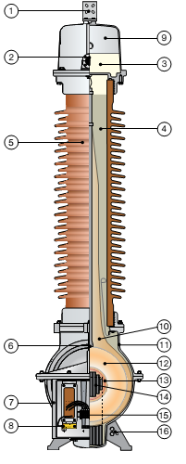
Abb emf 72kv transformer
1 | Primary terminal | 9 | Expansion system
2 | Oil level sight glass | 10 | Paper insulation
3 | Oil | 11 | Tank
4 | Quartz filling | 12 | Primary winding
5 | Insulator | 13 | Secondary winding
6 | Lifting lug | 14 | Core
7 | Secondary terminal box | 15 | Secondary terminals
8 | Neutral end terminal | 16 | Ground Connection

Slide 5
Design features and advantages
Windings – double enamelled
Core – very low flux
Impregnation
Aluminium tank – resistance to corrosion
Expansion system
Designed to counter ferroresonance
Designed for wide climatic changes
Quartz filling
Seismic strength

Slide 6
specifications

Slide 7
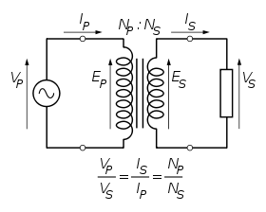
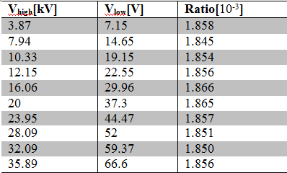
Measure transfer ratio full range
Measure low and high terminal voltages

Slide 8
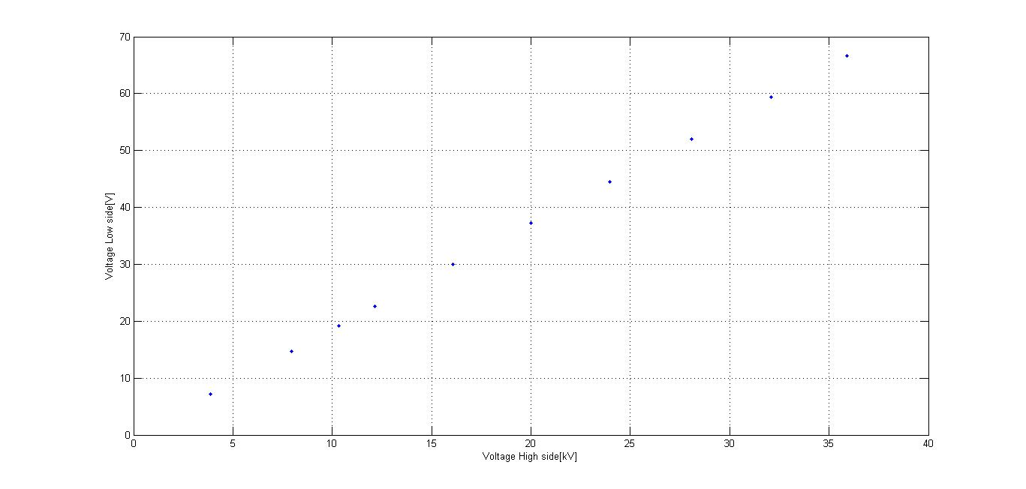
Measure transfer ratio full range
Calculate the slope of the graph
n ≈

Slide 9
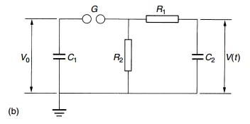
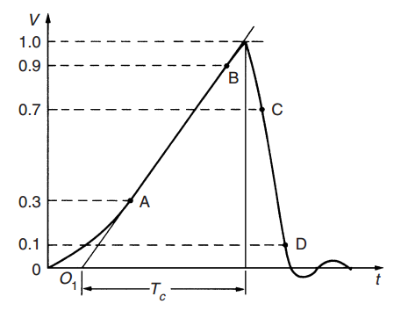
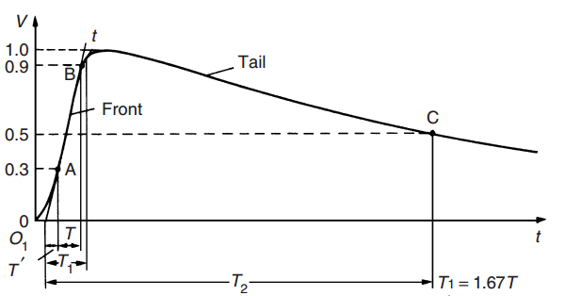
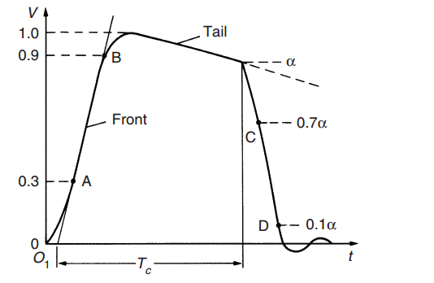
Impulse voltage
Three types of lightning impulse
- LI chopped on the front
- Full LI
- LI chopped on the tail
Type b circuit is more preferred

Slide 10
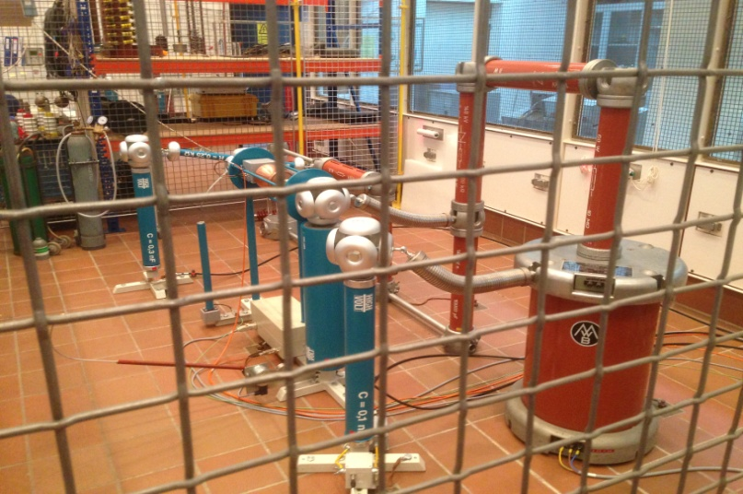
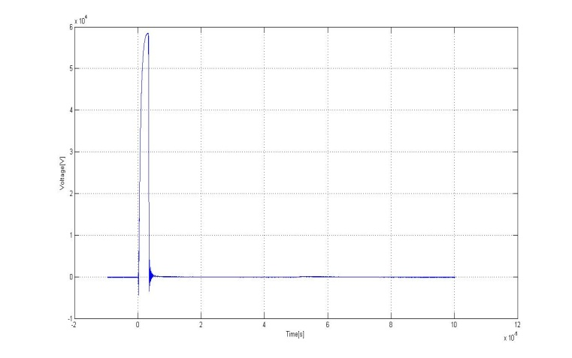
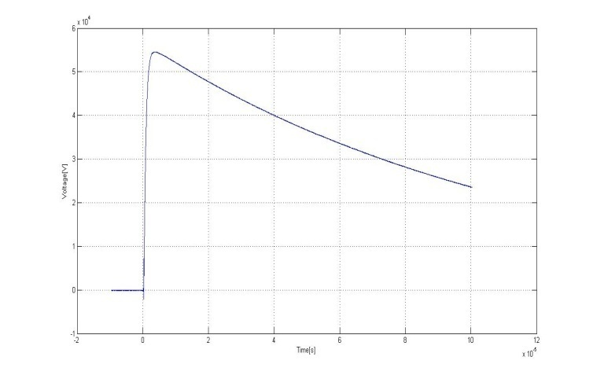
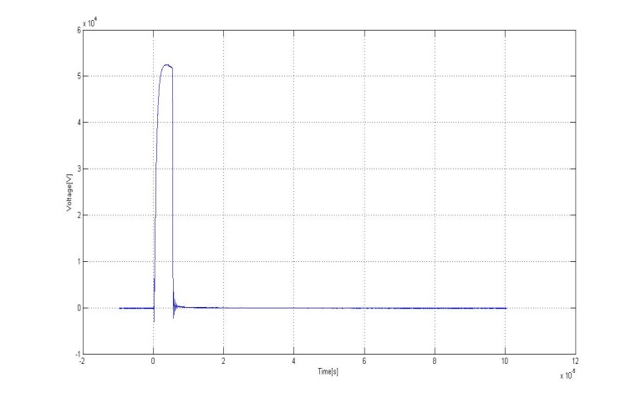
Impulse voltage
Three types of lightning impulse
- LI chopped on the front
- Full LI
- LI chopped on the tail
Type b circuit is more preferred

Slide 11
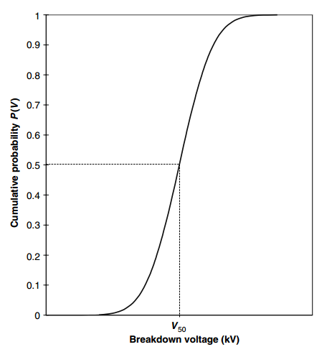
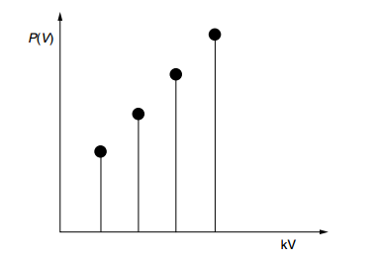
50 percent Breakdown voltage
Randomness of the result
V50 can be obtained from CDF
Multi-level method is used

Slide 12
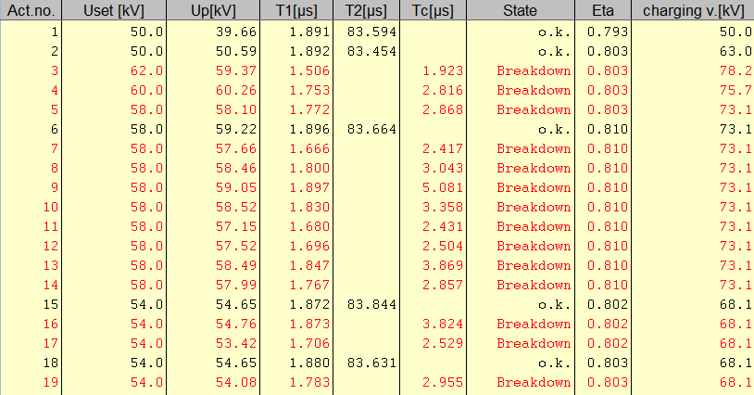
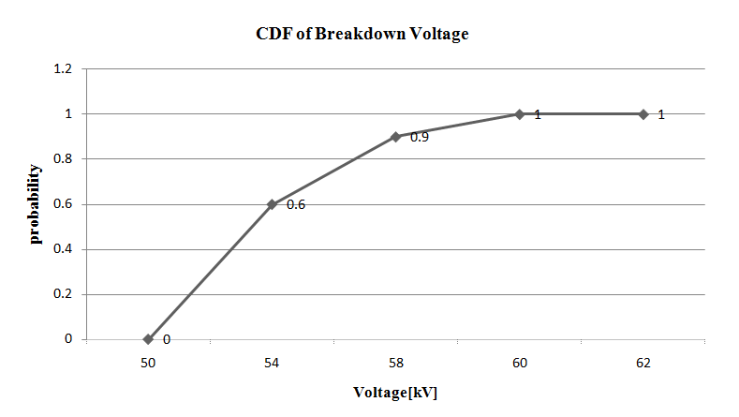
50 percent Breakdown voltage
V50 ≈ 53 kV
Limitation : number of test

Slide 13
Partial discharge measurement
Two types
Internal discharge
External discharge
1. Corona
2. Surface discharge
Responsible for losses and degradation of insulation

Slide 14
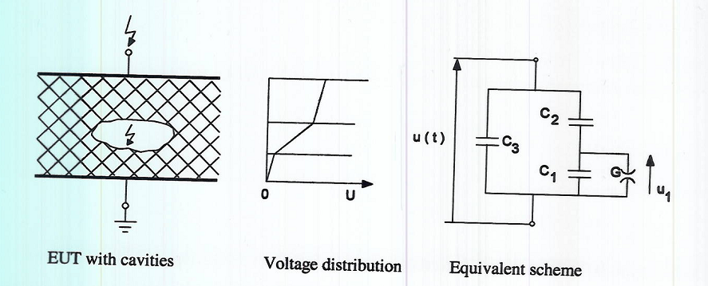
Internal discharge
Caused by
Voids in solid dielectric
Lower permittivity in void than surrounding media leading to higher stress and breakdown

Slide 15
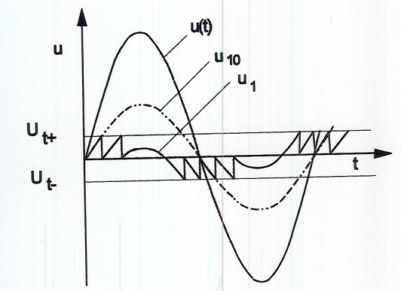
Internal discharge (contd)
C3>>C1>>C2
Voltage across C1=C2/(C1 + C2) ∗ um sin(wt)
Um> critical voltage discharge occurs
Higher the voltage multiple discharges depending on du/dt
Voltage across C1 in phase with applied voltage so discharge at zero crossings

Slide 16
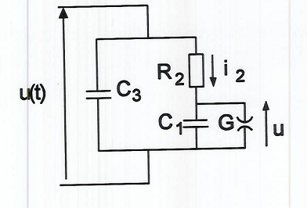
External discharge
Corona- occurs in gaseous medium under non uniform electric field
Surface discharge- along surface of two dielectrics of different permittivities
Equivalent scheme

Slide 17
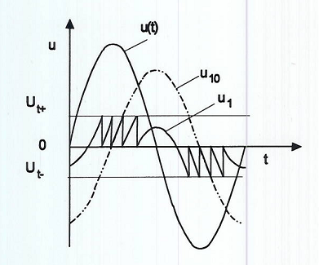
External discharge(contd)
R>>1/wc1
The voltage across C1 U₁₀ = um sin(wt − π/2)/wc*1r2
Discharge at um>critical voltage
Multiple discharges for higher um based on +-du/dt
Discharge frequency highest at maximum du/dt
Since voltage across capacitor lagging it occurs near peak values

Slide 18
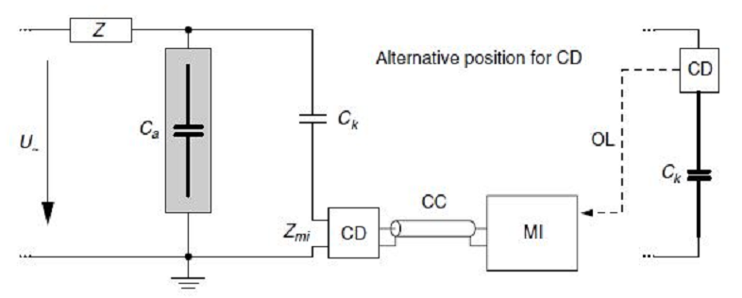
Test setup

Slide 19
Test setup(contd)
Apparent charge measurement followed
C_{k} –coupling capacitor compensates for charge drop in test specimen if(c_{k} > c_{a} )
Q value indication of partial discharge

Slide 20
Test specimens
ABB transformer
Homemade capacitor
Rod to plane electrode

Slide 21
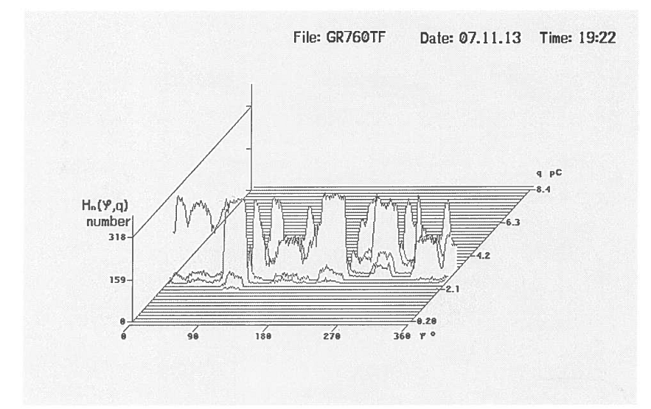
Results and analysis
ABB transformer – tested at 45kv
No measurable pd pulses attributed to noise

Slide 22
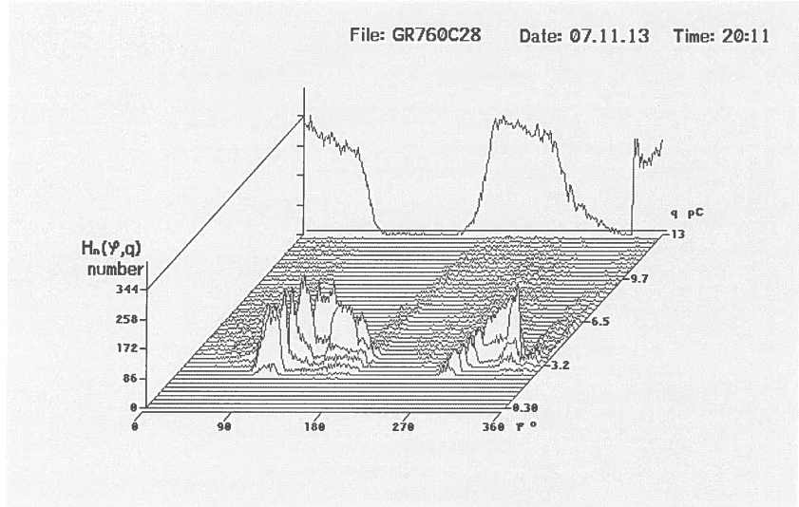
Results and analysis (contd)
Homemade capacitor –tested at 28 kV

Slide 23
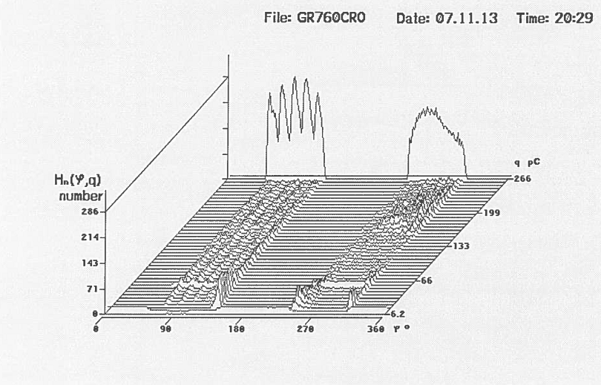
Results and analysis (contd)
Rod to plate electrode –tested at 24 kV
As discussed pd at peaks of supply voltage

Slide 24
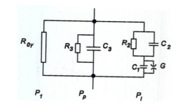
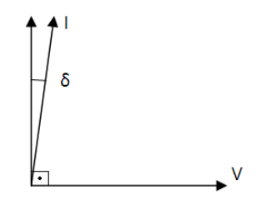
Loss angle measurement
Real dielectric have losses
-P1: conductive losses
-Pp: polarization losses
-Pi: ionization losses
Phasor diagram

Slide 25
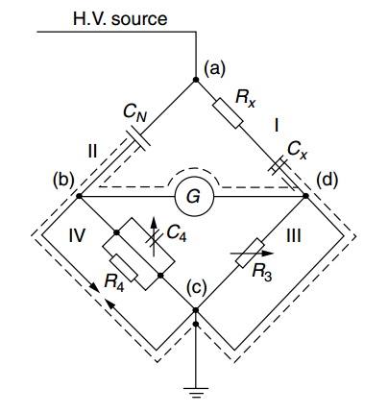

Dielectric Spectroscopy
Schering bridge
Cx Device under test
Cn Gas capacitor

Slide 26
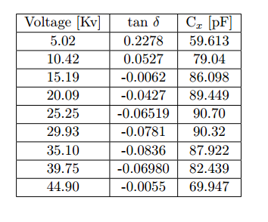
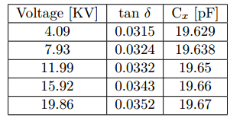
Results
Abb Transformer Home made Pure Capacitor
“Ionization knee”
It could be indication of partial discharges

Slide 27
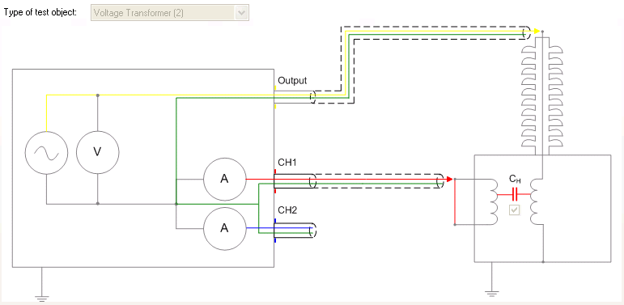
Dielectric spectroscopy
-Moisture can damage transformers and shorten its lifetime.
This method:
Test the properties of the insulation over wide frequency range (0.01-1000 Hz) in order to determine the moisture content.

Slide 28
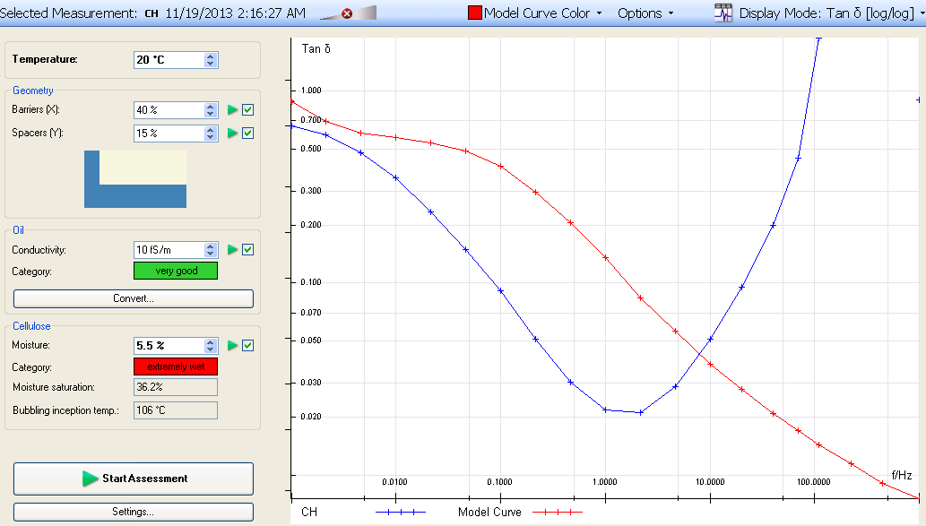
Results

Slide 29
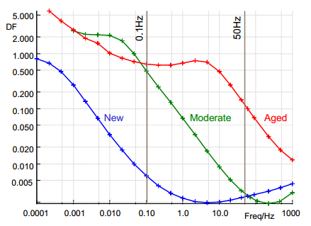
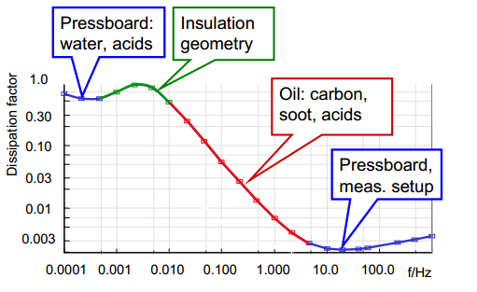
Interpretations
Maik Koch, Michael Krueger and Markus Puetter; Advanced Insulation Diagnostic
by Dielectric Spectroscopy, OMICRON

Slide 30
Tak!

